Slide 1
BeaconSafe System and User Journeys

Slide 2

01
Business Type: Smart roadside safety solution
02
Audience: Stranded motorists, first responders, municipalities
Business Overview
03
Technologies: LoRaWAN, high-lumen LEDs, IoT integration
04
Products: Roadside beacons, emergency notifications, monitoring
05
Value: Real-time visibility, proactive escalation, smart city adaptability

Slide 3
User Roles and Personas
Stranded Motorists
First Responders
Municipalities
Activate safety system, select mode, respond to checks.
Monitor alerts, respond to incidents, assess situation.
Access real-time updates, manage incidents and safety data.

Slide 4

Main Business Processes
Beacon Activation and User Safety Checks
Users activate BeaconSafe and select between modes. Safety checks are conducted on a schedule, with escalations if checks are missed.
Emergency Response and Real-Time Updates
In emergencies, BeaconSafe sends location and updates to responders, ensuring a rapid, prioritized response.
Remote Monitoring and Data Access
Municipalities monitor active units in real-time, with data supporting traffic management and city safety.

Slide 5

Real-Time Safety Monitoring
BeaconSafe conducts regular checks and escalates if no response, ensuring ongoing visibility and user safety.
System Capabilities
LoRaWAN enables real-time tracking and data sharing for incident logging, remote monitoring, and smart city integration.

Slide 6
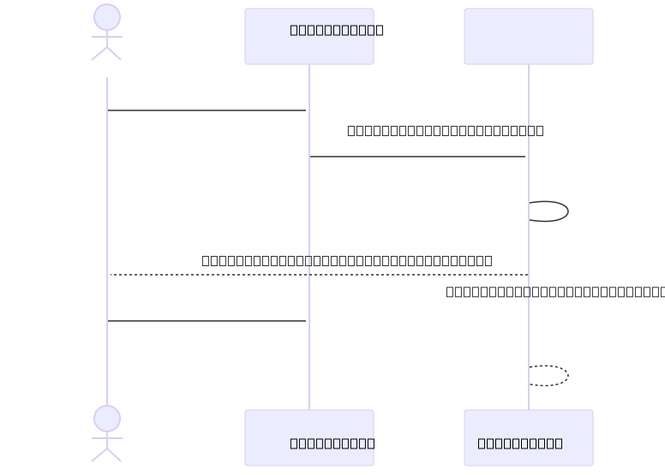
Stranded Motorists Standard Activation

Slide 7

Emergency Activation for Motorist

Slide 8

Municipal Monitoring for BeaconSafe

Slide 9
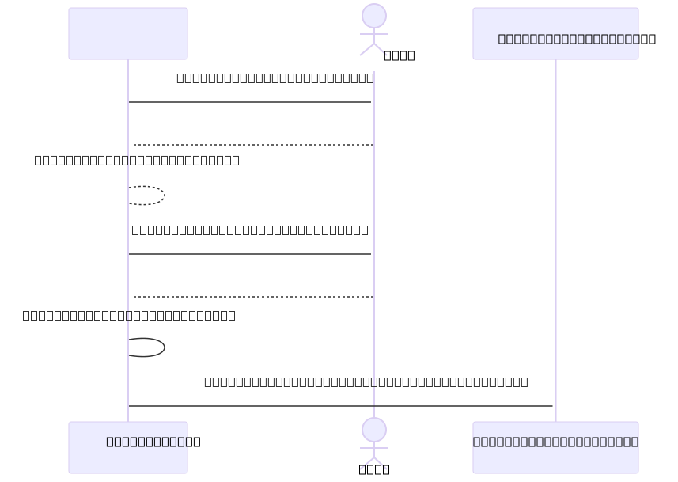
Automated Safety Check and Escalation

Slide 10

Environmental Monitoring and Smart City Integration

